Slide 1
Sequence Diagram

Slide 2
Sequence Diagram
The sequence diagram consists of objects represented in the usual way (as named rectangles with the name underlined), messages represented as solid-line arrows, and time represented as a vertical progression
Notes:
here are 3 types of Interaction diagrams; Sequence diagrams, communication diagrams, and timing diagrams. These diagrams are used to illustrate interactions between parts w
Sequence diagrams, commonly used by developers, model the interactions between objects in a single use case. They illustrate how the different parts of a system interact with each other to carry out a function, and the order in which the interactions occur when a particular use case is executed.ithin a system. Among the three, sequence diagrams are preferred by both developers and readers alike for their simplicity.

Slide 3
Objects
The objects are laid out near the top of the diagram from left to right..
Extending downward from each object is a dashed line called the object's lifeline.
Along the lifeline is a narrow rectangle called an activation. The activation represents an execution of an operation the object carries out. The length of the rectangle signifies the activation's duration.

Slide 4
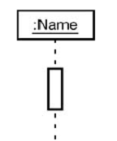
Representing an Object

Slide 5
Messages
A message that goes from one object to another goes from one object's lifeline to the other object's lifeline.
An object can also send a message to itself—that is, from its lifeline back to its own lifeline.

Slide 6
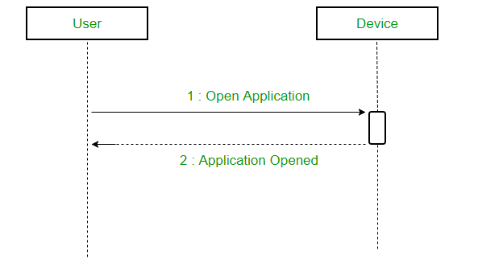
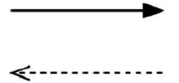
Types of Messages
Synchronous messages :
A synchronous message waits for a reply before the interaction can move forward.
The sender waits until the receiver has completed the processing of the message.
The caller continues only when it knows that the receiver has processed the previous message i.e. it receives a reply message.

Slide 7
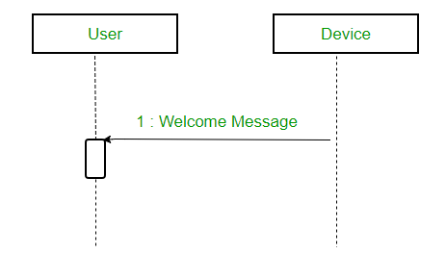
Asynchronous Message
With this one, the sender transfers control to the receiver and doesn't wait for the operation to complete.
An asynchronous message does not wait for a reply from the receiver. The interaction moves forward irrespective of the receiver processing the previous message or not. We use a lined arrow head to represent an asynchronous message

Slide 8
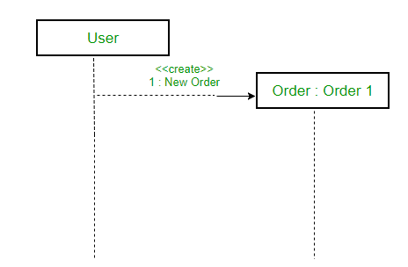
Create message
We use a Create message to instantiate a new object in the sequence diagram.
There are situations when a particular message call requires the creation of an object.
It is represented with a dotted arrow and create word labelled on it to specify that it is the create Message symbol.

Slide 9
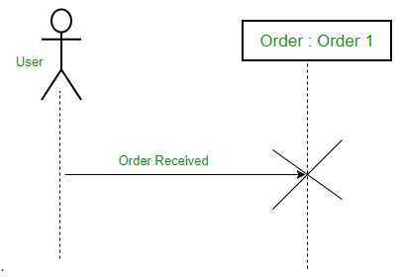
Delete Message
We use a Delete Message to delete an object.
When an object is deallocated memory or is destroyed within the system we use the Delete Message symbol.
It destroys the occurrence of the object in the system.
It is represented by an arrow terminating with a x

Slide 10
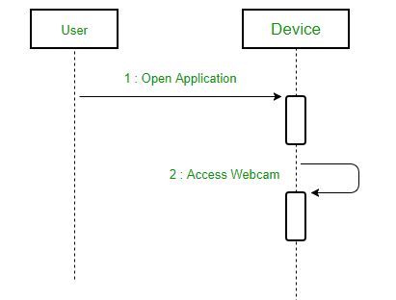
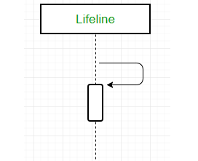
Self Message
Certain scenarios might arise where the object needs to send a message to itself. Such messages are called Self Messages .
For example – Consider a scenario where the device wants to access its webcam. Such a scenario is represented using a self message.

Slide 11
Time
The diagram represents time in the vertical direction: Time starts at the top and progresses toward the bottom.
Thus, the sequence diagram is two-dimensional. The left-to-right dimension is the layout of the objects, and the top-to-bottom dimension shows the passage of time.

Slide 12
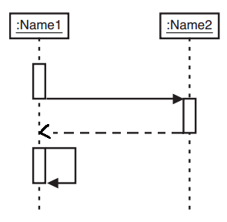
Symbols in a Sequence Diagram

Slide 13
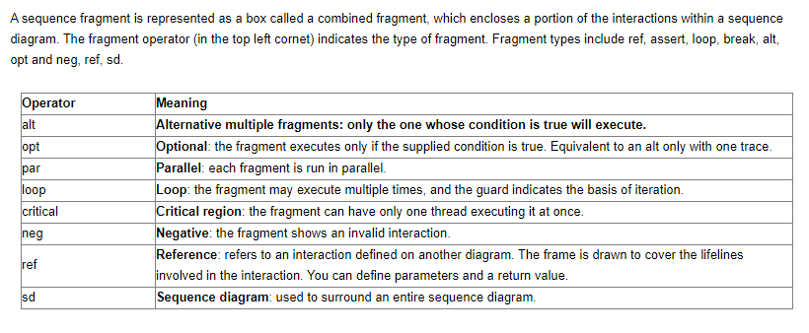
Sequence Fragments

Slide 14
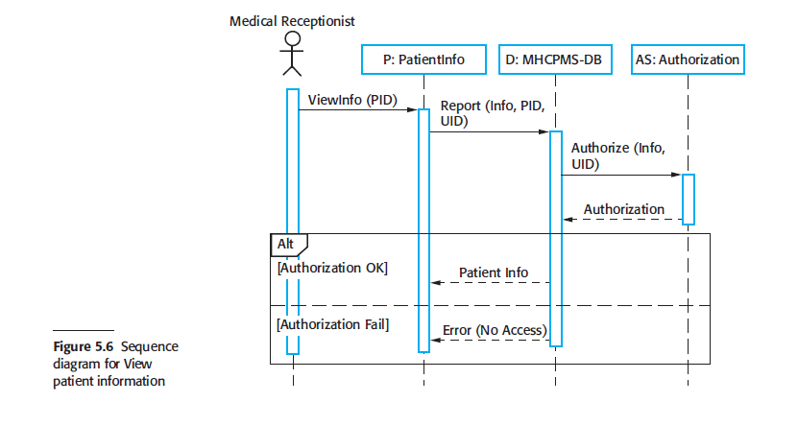
Sequence diagram for View patient information

Slide 15
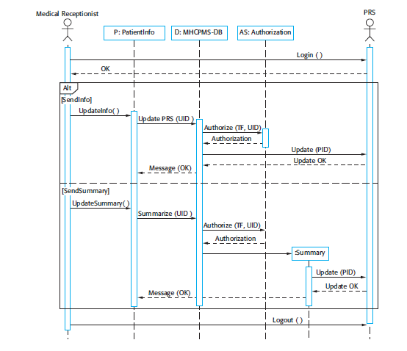
Sequence Diagram for Transfer Data

